Slide 1
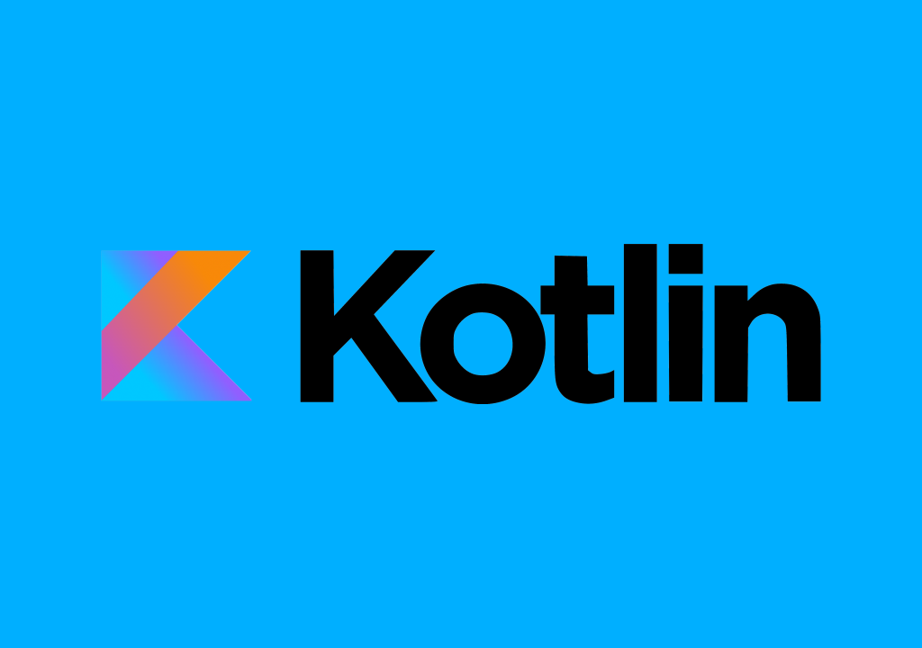

Slide 2
Kotlin is statically typed “pragmatic” programming language. It's statically typed like Java, C, and C++. It's also fully compatible with Java but has a much simpler syntax. Kotlin programming language to build the android applications.
Kotlin came when Android development needed a more modern language to add to the qualities of Java and aid in mobile development. JetBrains, the people who created IntelliJ, the integrated development environment also created Kotlin. At Google I/O 2017, Google Announced First-class Support For Kotlin On Android.

Slide 3
Kotlin is General Purpose Language that can run on the JVM, or being transpiled to JavaScript (with native compilation in the making). It means it can be used to write all sort of applications and those applications can run wherever we have a JVM (so basically everywhere) and even in the browser.
It also means that it can reuse Java libraries or Javascript libraries.

Slide 4
The language itself is a modern, concise and powerful language. It does not present a revolution w.r.t. existing languages, it just permits to developers to write understandable code easily. It supports data classes, lambdas, functional programming and object-oriented programming.

Slide 6
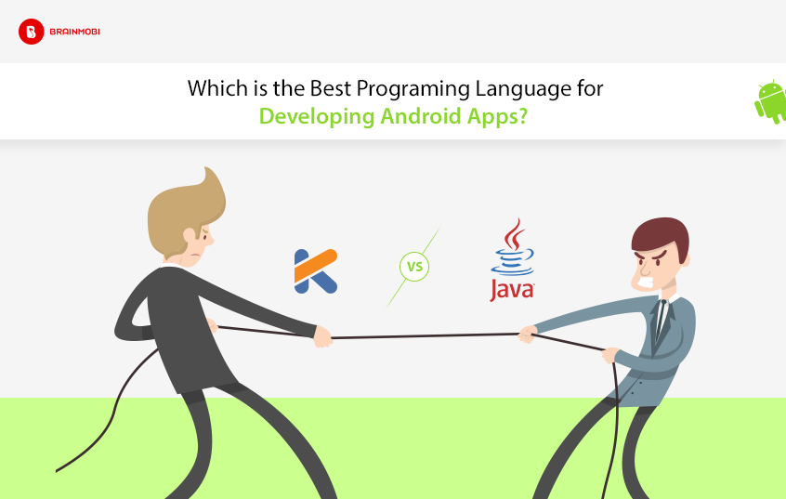

Slide 7
Kotlin features enable more concise and understandable code than Java without sacrificing performance or safety. Kotlin compiles to bytecode, so it can perform just as well as Java. It's got the same compile-time checks as Java. And most importantly, Kotlin's language features and standard library functions enable succinct, effective code.
Kotlin can convert any Java code into its Kotlin equivalent and this way the Java coders are not left behind with its open source communit.

Slide 8
